Slide 1
Strategies in Market Dynamics: Leveraging Game Theory and Bayesian Persuasion to Enhance High-Value Bidding in Real Estate Transactions
Qi Guo
BADM 504

Slide 2
Motivation and Background
Real Estate Market Dynamics: It's important to consider how market conditions (like supply and demand, economic trends, and regional factors) impact property prices.
Role of Agents in Real Estate: Their strategies, motivations, and how they impact the market would be crucial components of the background.
Game Theory in Economics: It would be used to model and understand the behaviors and decisions of bidders, sellers, and agents.
Bayesian Persuasion and Information Asymmetry: It would help in understanding how beliefs and expectations are shaped in the context of property valuation.
Practical Challenges in Real Estate Transactions: It would address the practical challenges faced by agents and participants in real estate markets.

Slide 3
Research Questions
Do the seller's agent significantly influence bidders on the bidding price in real estate transactions?

Slide 4
Literature Review
Principal-Agent Relationship:
the principal’s (seller's) problem is to design a contract that induces the agent to adopt a selling strategy that maximizes the owner's expected return (Arnold 1992). In some cases, real-estate agents even drive up the cost of homes by pushing for all-cash offers that trigger automatic bidding wars (Schwartz 2022).
Bayesian Persuasion in Real Estate:
seller to disclose inefficiently more information and charge a higher price, resulting in fewer sales and lower profit (Chen Zhang 2020).
Game Theory in Real Estate:
how agents, by withholding or selectively disclosing information, can influence bidders to bid higher than their true value, a tactic that aligns with game theory principles (BANTA 2023).

Slide 5
Criteria
Search String Definition:
Primary Keywords: Start with core terms directly related to your research question. For instance, "real estate transactions," "game theory," and "Bayesian persuasion."
Extended Keywords: Include related terms to broaden the search scope, such as "property bidding," "market dynamics," "strategic communication in real estate," and "information asymmetry in property sales."
Total Search Strings: Combine these primary and extended keywords in various ways to create a comprehensive list of search strings, ensuring a wide coverage of relevant topics.

Slide 6
Criteria
2. Inclusion/Exclusion Criteria (C-I-M-O Paradigm):
1. Context (C): Focus on studies that are set in the context of real estate markets, particularly those involving high-value transactions.
2. Intervention (I): Include studies where game theory or Bayesian persuasion are used as strategic tools or frameworks in real estate transactions.
3. Mechanism (M): Look for articles that explore how these theories influence bidder behavior or transaction outcomes.
4. Outcome (O): Focus on studies that analyze the impact of these strategies on the bidding price, sale price, or market dynamics.

Slide 7
Criteria
3.Source Selection:
Choose databases and journals that are renowned for their focus on economics, real estate, and strategic decision-making to ensure the quality and relevance of the sources.
4. Manual Checks:
Perform manual checks on all publications that meet the search string criteria based on their abstracts, ensuring they are relevant to my topic.

Slide 8
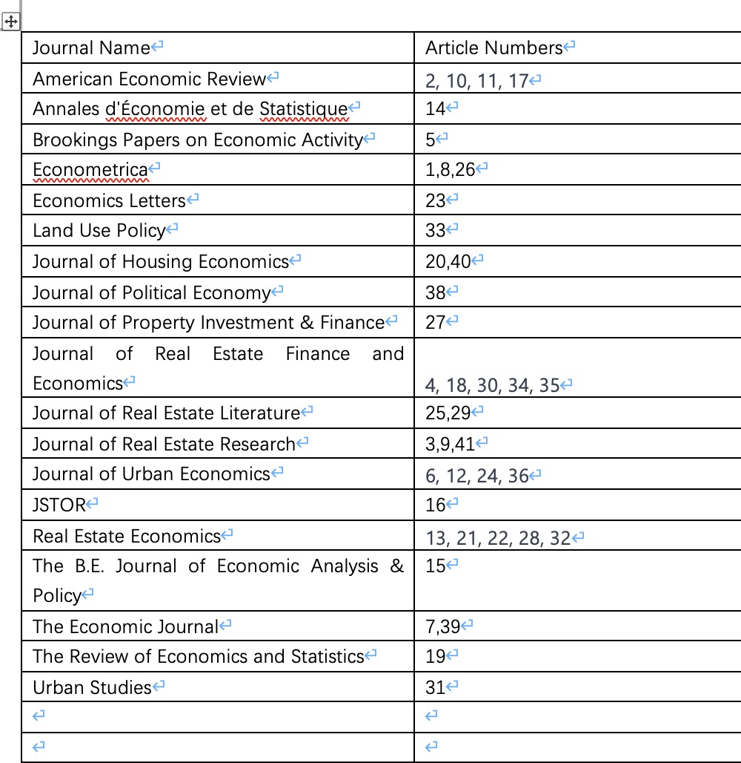
40 articles

Slide 9
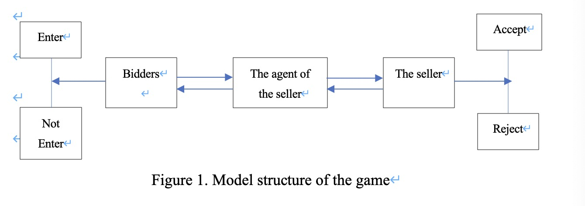
Model – set up

Slide 10
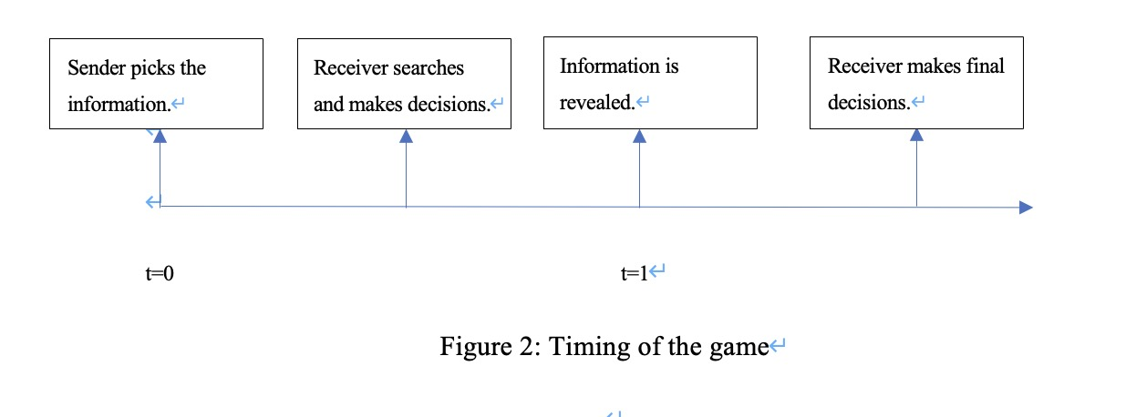
Model - timing

Slide 11
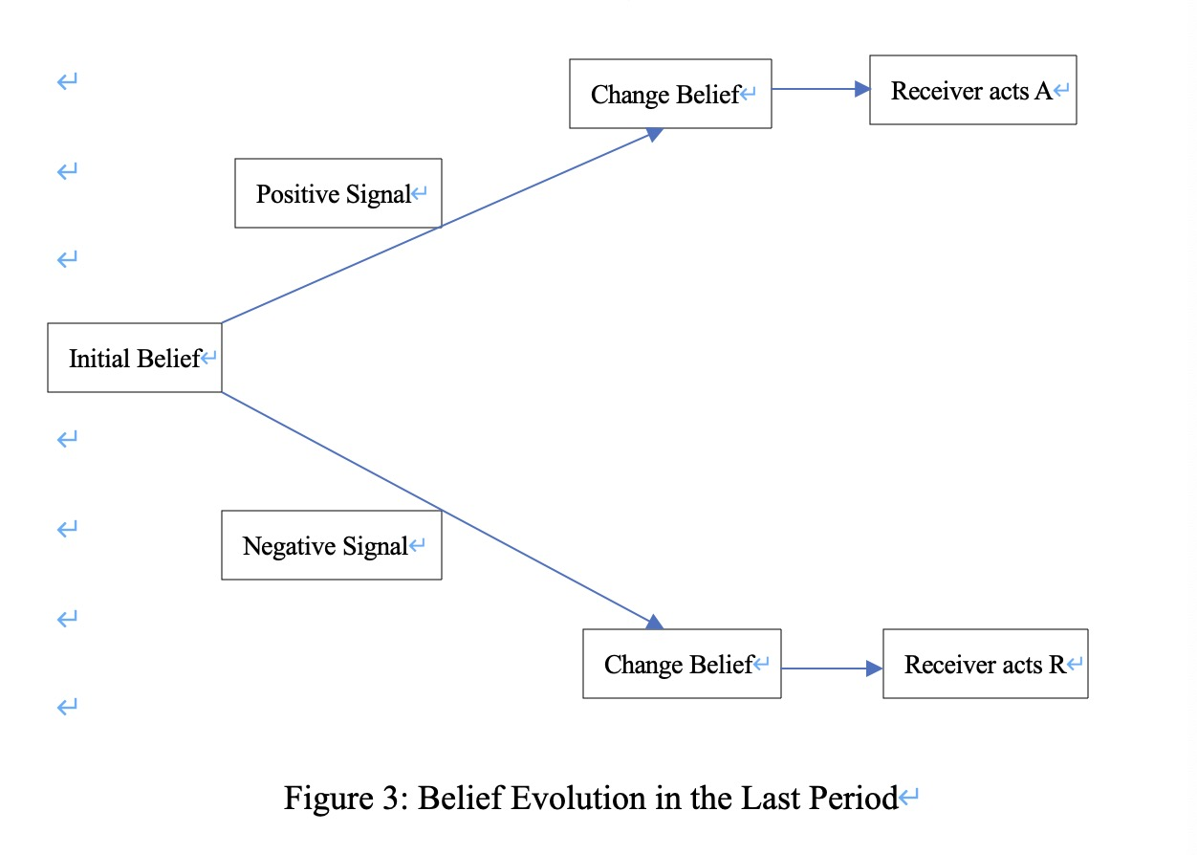
Model - belief

Slide 12
Assumptions
Information Asymmetry: The agent possesses more comprehensive information about the property and market trends than bidders.
Rational Behavior: All participants are rational and aim to maximize their utility bidders want to buy at the lowest possible price, whereas the seller wants to sell at the highest.
Market Dynamics: The real estate market is competitive, with multiple bidders for desirable properties.

Slide 13
Results and Future Study
The findings from this review contribute significantly to the understanding of strategic dynamics in real estate transactions.
The potential of game theory and Bayesian persuasion as powerful tools in shaping market outcomes.
However, I also underscore the need for a careful and nuanced application of these theories, considering the real-world complexities and ethical considerations inherent in real estate transactions

Slide 14
Any Questions?
Thank You!

